Slide 1


C Games
#include <fun.h>
int main ( )
{
/*
where fun begins;
*/
}
return 0;

Slide 2
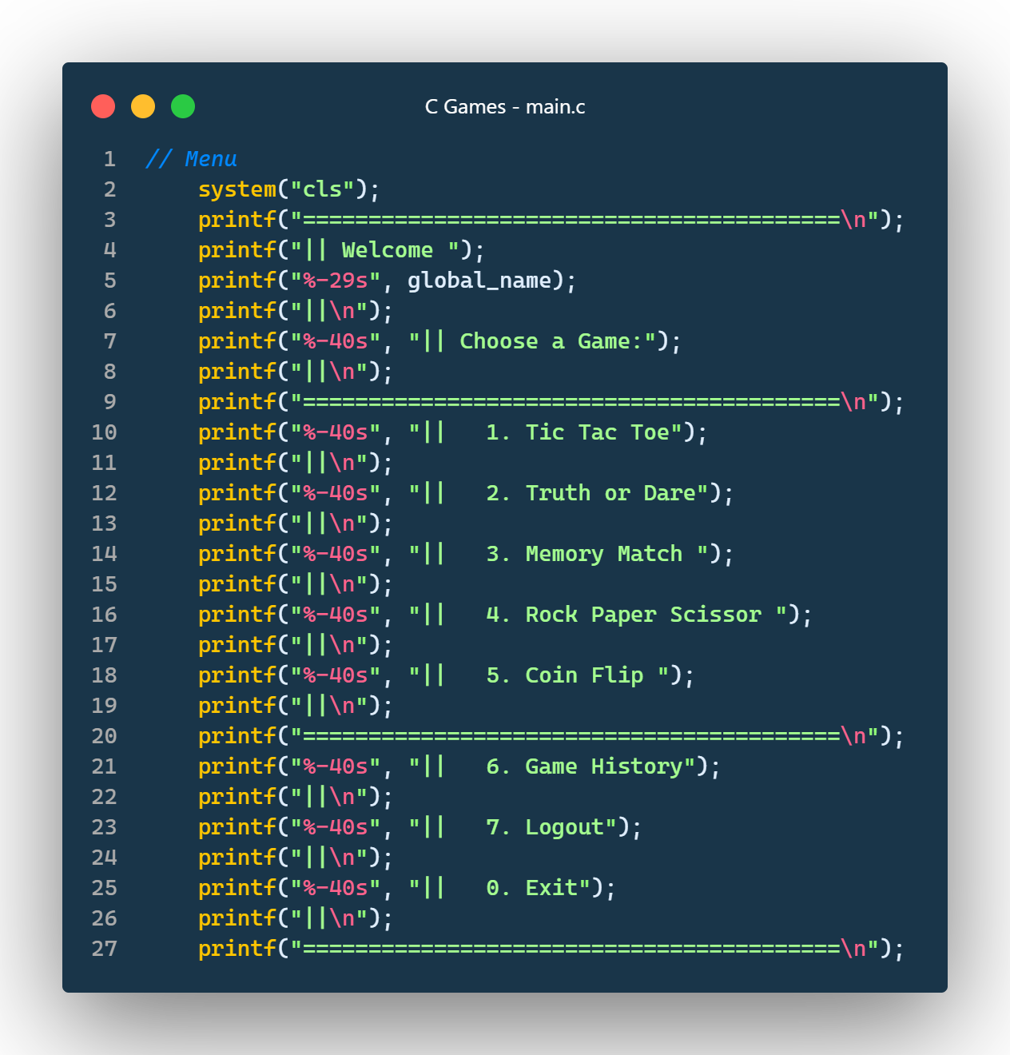
INTRODUCTION
Welcome to C Games - a hub of entertainment and excitement! With a seamless login system and a variety of captivating games, you are in for a delightful gaming experience. Get ready to embark on a thrilling journey of fun and games! Let's dive in!

Slide 3
Team Members
Tilak Thapa
Utsab Pandey
Sumit Rijal
Sagar Mainali
BCT-CD-094
BCT-CD-095
BCT-CD-XXX
BCT-CD-069

Slide 4
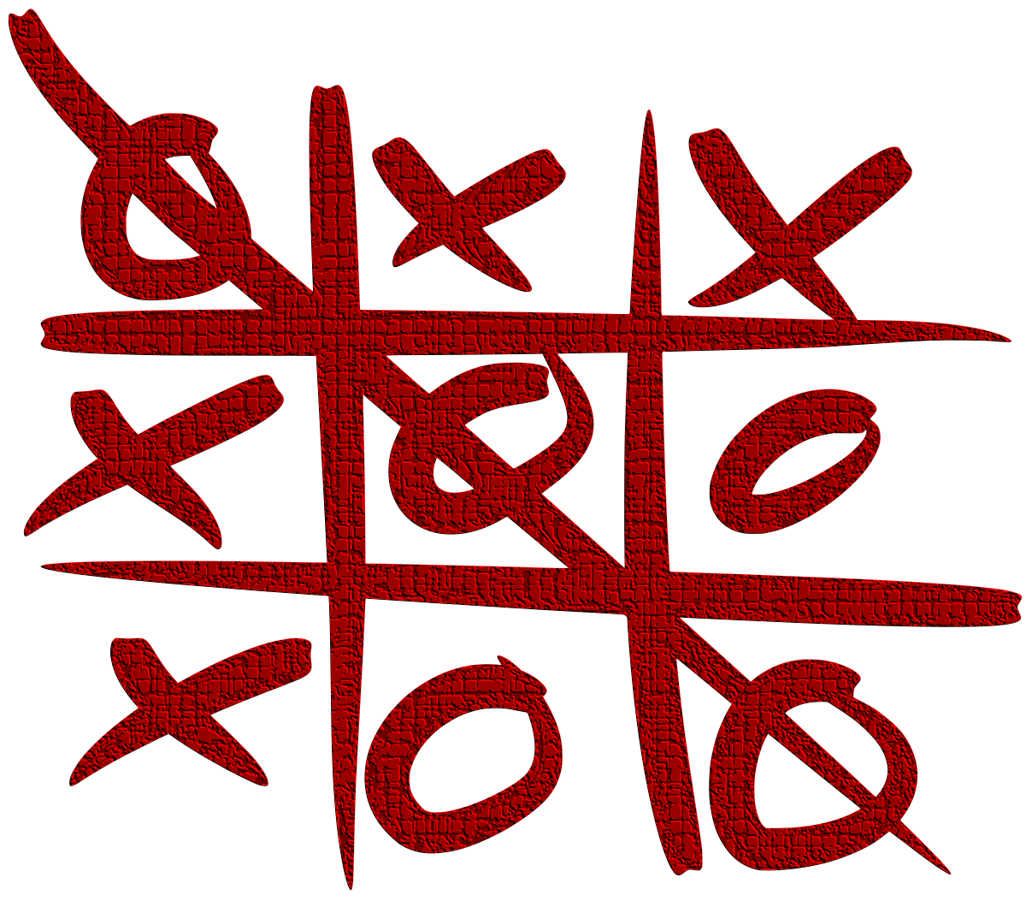
Tic Tac Toe
You can replace the image on the screen with your own work. Just delete this one, add yours and center it properly

Slide 5

Truth or Dare
You can replace the image on the screen with your own work. Just delete this one, add yours and center it properly

Slide 6

Memory Match
You can replace the image on the screen with your own work. Just delete this one, add yours and center it properly

Slide 7

Rock Paper Scissor
You can replace the image on the screen with your own work. Just delete this one, add yours and center it properly

Slide 8

Coin Flip
You can replace the image on the screen with your own work. Just delete this one, add yours and center it properly

Slide 9
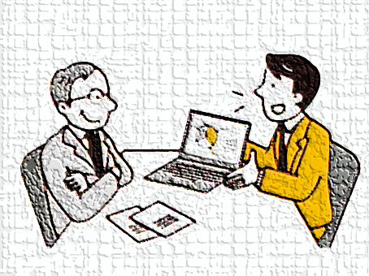
LIVE DEMONSTRATION
Effective more than thousand words of explanation………….

Slide 10
THANKS!
Do you have any questions?
https://github.com/jrTilak/C-Games

